Slide 1

IOT Based Smart Solar Panel

Slide 2
A) What the project is about?
The project aims at developing a smarter version of the solar unit installed in our houses for power production.
Solar units being installed in our households are just a basic installation, that sets up the panels and then these panel produce power which are then stored either in inverter or are transmitted to the electricity board.
The project aims to make this into a smarter version, which would give real time updates and information to the users.
The project is a solar power unit which would be smart enough to track the intensity of the sunlight and adjust its panels (left to right) to obtain maximum sunlight for the panels.
User can also monitor the live production of power through a mobile app, this interface would give the user an insight on the efficiency of the power plant.

Slide 3
B) Tech Stack
Hardware:
Arduino Uno R3: Microcontroller board for handling the core operations.
LDRs (Light Dependent Resistors): Sensors for detecting sunlight intensity.
Servo Motor: To adjust the solar panel position based on LDR readings.
ESP8266 Wi-Fi Module: To enable wireless communication and send data to ThingSpeak.
Solar Panel: Core component for energy harvesting.
Relay Module: Optional for switching components like the solar panel or other electrical loads.
Power Supply/Battery: To power the Arduino and modules.

Slide 4
B) Tech Stack (Cont.)
Software & Libraries:
Arduino IDE (C/C++): Primary development environment for writing and uploading code.
Servo.h: Library for controlling the servo motor.
ESP8266WiFi.h: For Wi-Fi communication with the ESP8266 module.
ThingSpeak.h: Library to send data to the ThingSpeak IoT platform.
SoftwareSerial.h: For serial communication between the Arduino and the ESP8266 module.
Cloud Platform:
ThingSpeak Server: IoT analytics platform to store and visualize sensor data remotely. You’ll be sending LDR readings to ThingSpeak for real-time monitoring.
Protocols:
HTTP GET/POST: Used by the ESP8266 to send data to the ThingSpeak server.

Slide 5
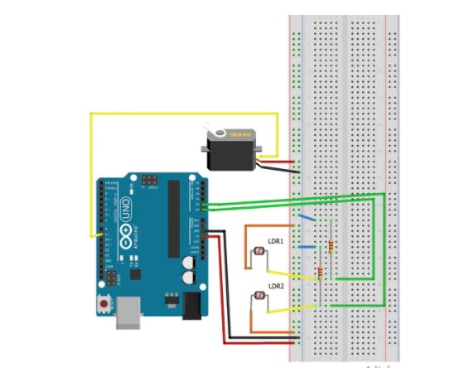
C) Project Circuit Diagram

Slide 6
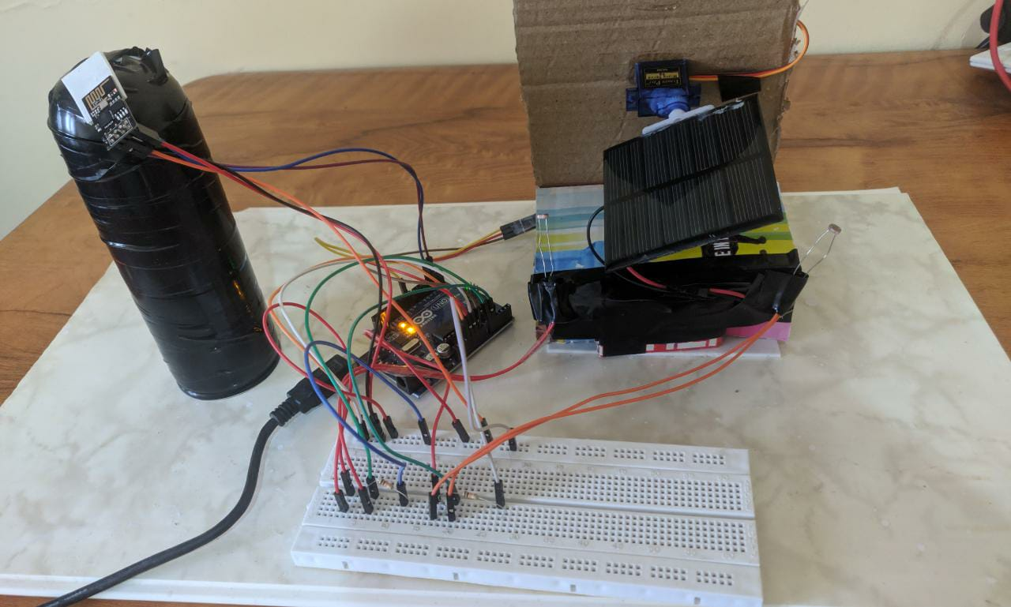
D) Constructed Project

Slide 7
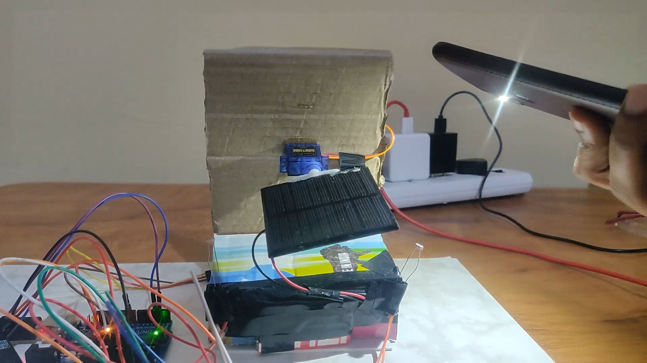
E) Practical demo

Slide 8
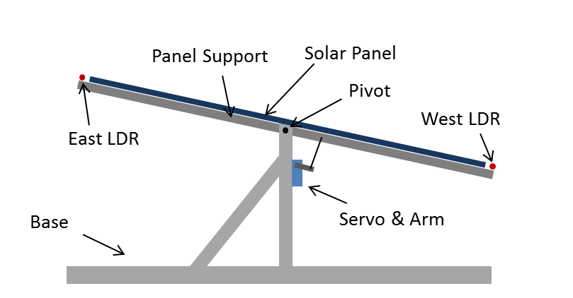
F) Geographical Deployment

Slide 9
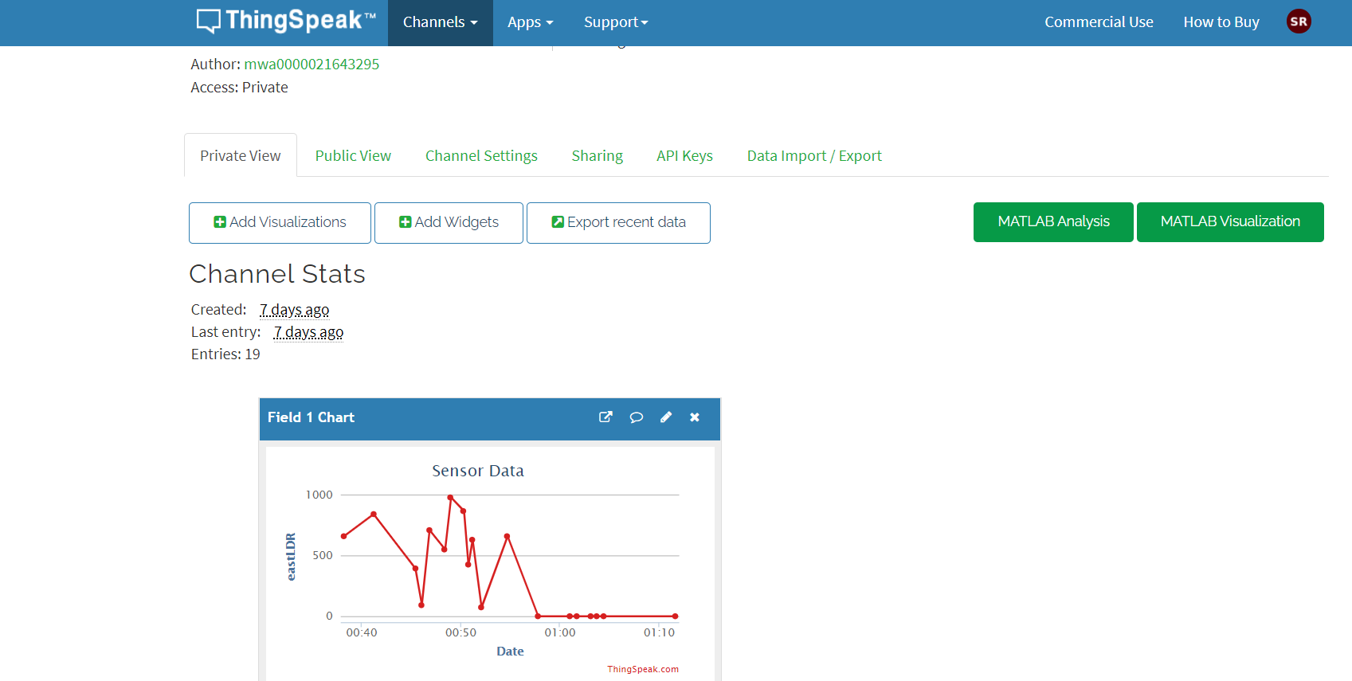
G) Data Collection

Slide 10
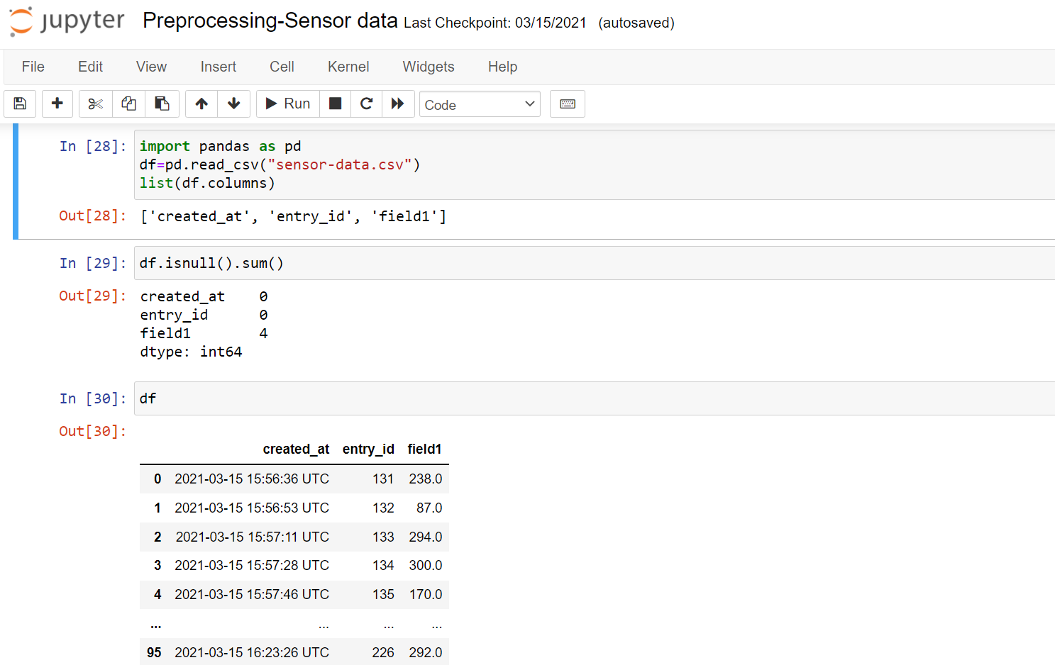
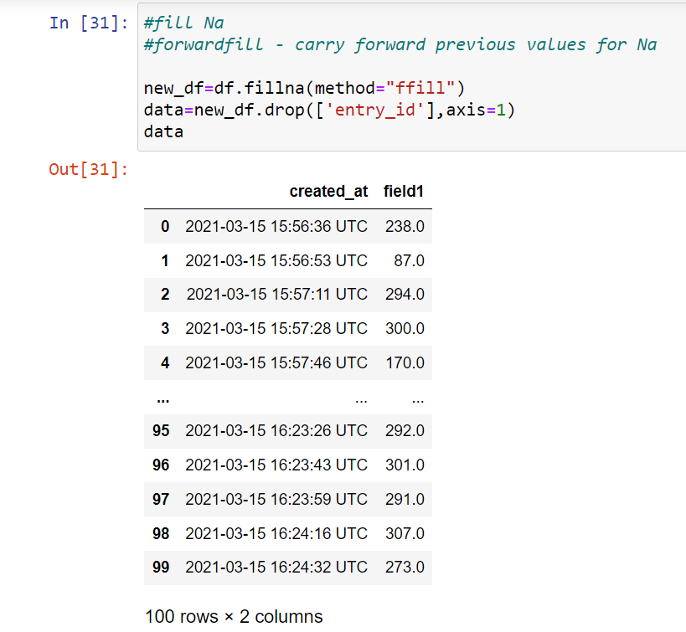
H) Data analysis

Slide 11
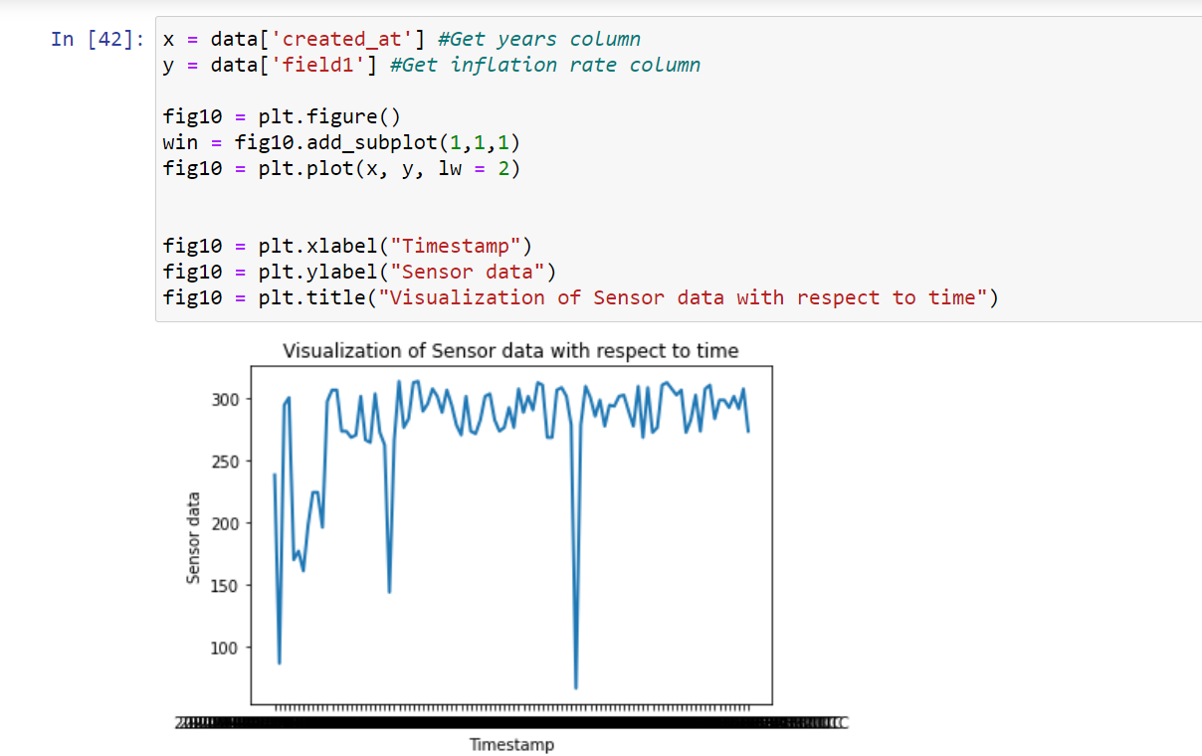
I) Data visualization

Slide 12
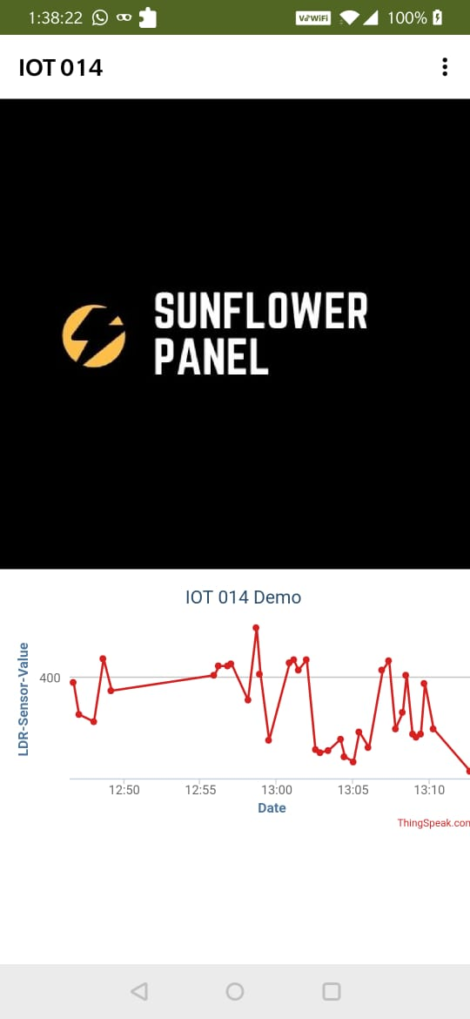
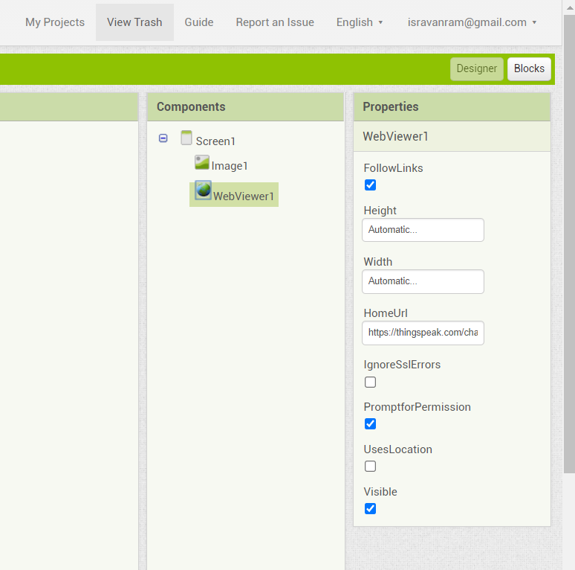
J) App Interface

Slide 13


